Slide 1
Finding News Curators in Twitter

Slide 2
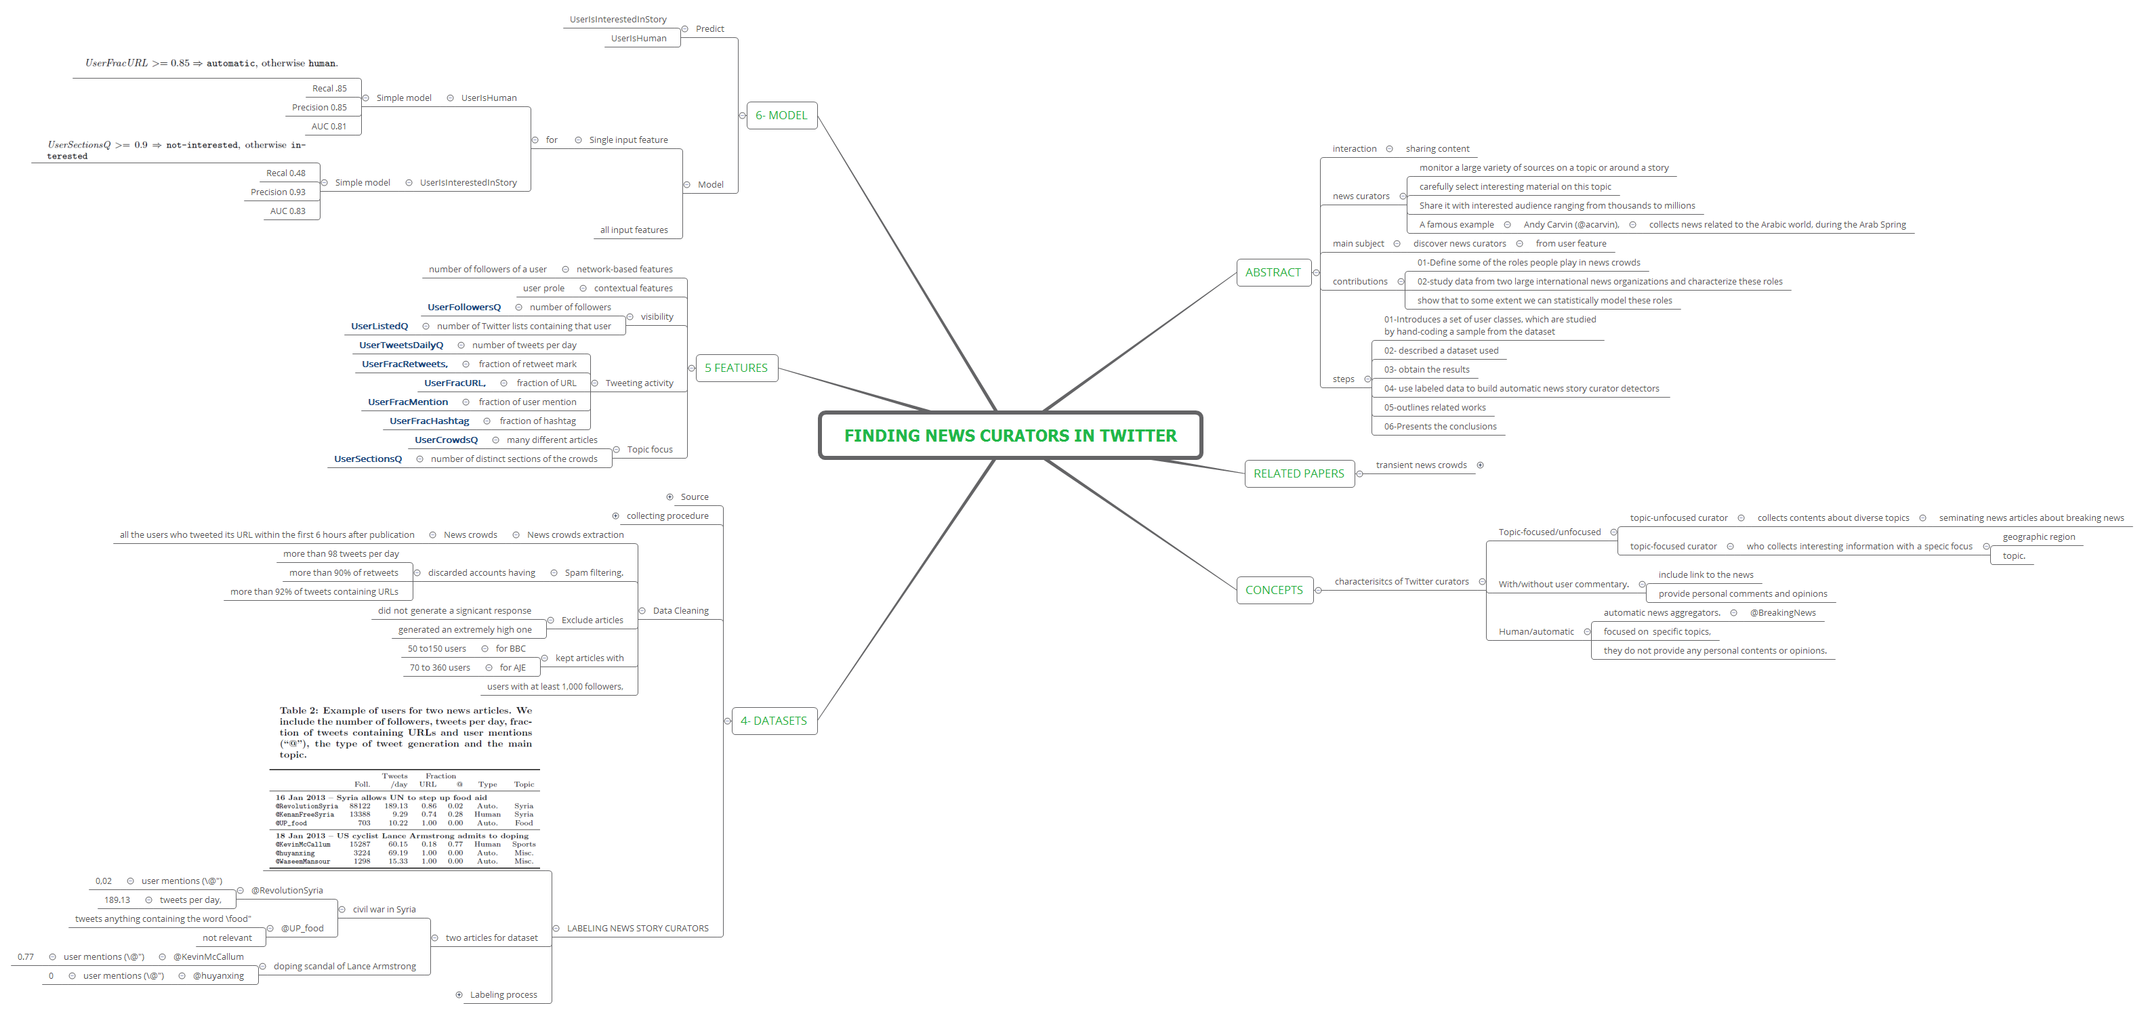
Finding News Curators in Twitter

Slide 3
abstract
interaction
news curators
main subject
contributions
steps

Slide 4
interaction
sharing content

Slide 5
sharing content

Slide 6
news curators
monitor a large variety of sources on a topic or around a story
carefully select interesting material on this topic
Share it with interested audience ranging from thousands to millions
A famous example

Slide 7
monitor a large variety of sources on a topic or around a story

Slide 8
carefully select interesting material on this topic

Slide 9
Share it with interested audience ranging from thousands to millions

Slide 10
A famous example
Andy Carvin (@acarvin),

Slide 11
Andy Carvin (@acarvin),
collects news related to the Arabic world, during the Arab Spring

Slide 12
collects news related to the Arabic world, during the Arab Spring

Slide 13
main subject
discover news curators

Slide 14
discover news curators
from user feature

Slide 15
from user feature

Slide 16
contributions
01-Define some of the roles people play in news crowds
02-study data from two large international news organizations and characterize these roles
show that to some extent we can statistically model these roles

Slide 17
01-Define some of the roles people play in news crowds

Slide 18
02-study data from two large international news organizations and characterize these roles

Slide 19
show that to some extent we can statistically model these roles

Slide 20
steps
01-Introduces a set of user classes, which are studied
02- described a dataset used
03- obtain the results
04- use labeled data to build automatic news story curator detectors
05-outlines related works
06-Presents the conclusions
by hand-coding a sample from the dataset

Slide 21
01-Introduces a set of user classes, which are studied
by hand-coding a sample from the dataset

Slide 22
02- described a dataset used

Slide 23
03- obtain the results

Slide 24
04- use labeled data to build automatic news story curator detectors

Slide 25
05-outlines related works

Slide 26
06-Presents the conclusions

Slide 27
related papers
transient news crowds

Slide 28
transient news crowds
Transient news crowds in social media. In ICWSM, 2013

Slide 29
Transient news crowds in social media. In ICWSM, 2013

Slide 30
CONCEPTS
characterisitcs of Twitter curators

Slide 31
characterisitcs of Twitter curators
Topic-focused/unfocused
With/without user commentary.
Human/automatic

Slide 32
Topic-focused/unfocused
topic-unfocused curator
topic-focused curator

Slide 33
topic-unfocused curator
collects contents about diverse topics

Slide 34
collects contents about diverse topics
seminating news articles about breaking news

Slide 35
seminating news articles about breaking news

Slide 36
topic-focused curator
who collects interesting information with a speci_x000c_c focus

Slide 37
who collects interesting information with a speci_x000c_c focus
geographic region
topic.

Slide 38
geographic region

Slide 39
topic.

Slide 40
With/without user commentary.
include link to the news
provide personal comments and opinions

Slide 41
include link to the news

Slide 42
provide personal comments and opinions

Slide 43
Human/automatic
automatic news aggregators.
focused on specific topics,
they do not provide any personal contents or opinions.

Slide 44
automatic news aggregators.
@BreakingNews

Slide 45
@BreakingNews

Slide 46
focused on specific topics,

Slide 47
they do not provide any personal contents or opinions.

Slide 48
4- DATASETS
Source
collecting procedure
Data Cleaning
LABELING NEWS STORY CURATORS

Slide 49
Source
two online news websites

Slide 50
two online news websites
BBC World Service (BBC)
Al Jazeera English (AJE).

Slide 51
BBC World Service (BBC)

Slide 52
Al Jazeera English (AJE).

Slide 53
collecting procedure
downloaded periodically the homepage of each of these websites,
get headline news
get sampled at random a subset of news articles.
sampled articles

Slide 54
downloaded periodically the homepage of each of these websites,

Slide 55
get headline news

Slide 56
get sampled at random a subset of news articles.

Slide 57
sampled articles
use Twitter's API

Slide 58
use Twitter's API
_x000c_nd tweets containing that article's URL.

Slide 59
_x000c_nd tweets containing that article's URL.

Slide 60
Data Cleaning
News crowds extraction
Spam filtering.
Exclude articles
kept articles with
users with at least 1,000 followers,

Slide 61
News crowds extraction
News crowds

Slide 62
News crowds
all the users who tweeted its URL within the first 6 hours after publication

Slide 63
all the users who tweeted its URL within the first 6 hours after publication

Slide 64
Spam filtering.
discarded accounts having

Slide 65
discarded accounts having
more than 98 tweets per day
more than 90% of retweets
more than 92% of tweets containing URLs

Slide 66
more than 98 tweets per day

Slide 67
more than 90% of retweets

Slide 68
more than 92% of tweets containing URLs

Slide 69
Exclude articles
did not generate a signi_x000c_cant response
generated an extremely high one

Slide 70
did not generate a signi_x000c_cant response

Slide 71
generated an extremely high one

Slide 72
kept articles with
for BBC
for AJE

Slide 73
for BBC
50 to150 users

Slide 74
50 to150 users

Slide 75
for AJE
70 to 360 users

Slide 76
70 to 360 users

Slide 77
users with at least 1,000 followers,

Slide 78
LABELING NEWS STORY CURATORS
two articles for dataset
Labeling process

Slide 79
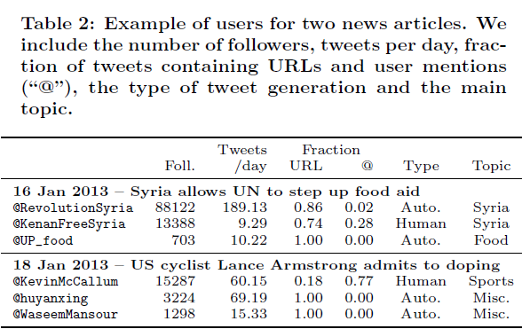

Slide 80
two articles for dataset
civil war in Syria
doping scandal of Lance Armstrong

Slide 81
civil war in Syria
@RevolutionSyria
@UP_food

Slide 82
@RevolutionSyria
user mentions (\@")
tweets per day,

Slide 83
user mentions (\@")
0,02

Slide 84
0,02

Slide 85
tweets per day,
189.13

Slide 86
189.13

Slide 87
@UP_food
tweets anything containing the word \food"
not relevant

Slide 88
tweets anything containing the word \food"

Slide 89
not relevant

Slide 90
doping scandal of Lance Armstrong
@KevinMcCallum
@huyanxing

Slide 91
@KevinMcCallum
user mentions (\@")

Slide 92
user mentions (\@")
0.77

Slide 93
0.77

Slide 94
@huyanxing
user mentions (\@")

Slide 95
user mentions (\@")
0

Slide 96
0

Slide 97
Labeling process
sample of 20 news articles:
for each article
three volunteers to provide labels.

Slide 98
sample of 20 news articles:
10 from AJE,
10 from BBC

Slide 99
10 from AJE,

Slide 100
10 from BBC

Slide 101
for each article
sample random 10 users who posted the article

Slide 102
sample random 10 users who posted the article
tweets that were posted directly after the news article,
number of follower
profile description

Slide 103
tweets that were posted directly after the news article,

Slide 104
number of follower

Slide 105
profile description

Slide 106
three volunteers to provide labels.
Q1
Q2
discard may be and unknown

Slide 107
Q1
User interested in the topic ??

Slide 108
User interested in the topic ??
Yes
May Be
No
Unknown

Slide 109
Yes
most tweet related to the topic

Slide 110
most tweet related to the topic

Slide 111
May Be
many tweet about the topic

Slide 112
many tweet about the topic

Slide 113
No
not tweeting about the topic expect this tweet

Slide 114
not tweeting about the topic expect this tweet

Slide 115
Unknown
can not label

Slide 116
can not label

Slide 117
Q2
human ?

Slide 118
human ?
Human
Maybe automatic
Automatic
Unknown

Slide 119
Human
user has conversations and personal comments in his tweets.

Slide 120
user has conversations and personal comments in his tweets.

Slide 121
Maybe automatic

Slide 122
Automatic

Slide 123
Unknown

Slide 124
discard may be and unknown

Slide 125
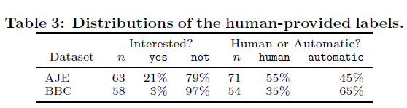

Slide 126
5 Features
network-based features
contextual features
visibility
Tweeting activity
Topic focus

Slide 127
network-based features
number of followers of a user

Slide 128
number of followers of a user

Slide 129
contextual features
user pro_x000c_le

Slide 130
user pro_x000c_le

Slide 131
visibility
number of followers
number of Twitter lists containing that user

Slide 132
number of followers
UserFollowersQ

Slide 133
UserFollowersQ

Slide 134
number of Twitter lists containing that user
UserListedQ

Slide 135
UserListedQ

Slide 136
Tweeting activity
number of tweets per day
fraction of retweet mark
fraction of URL
fraction of user mention
fraction of hashtag

Slide 137
number of tweets per day
UserTweetsDailyQ

Slide 138
UserTweetsDailyQ

Slide 139
fraction of retweet mark
UserFracRetweets,

Slide 140
UserFracRetweets,

Slide 141
fraction of URL
UserFracURL,

Slide 142
UserFracURL,

Slide 143
fraction of user mention
UserFracMention

Slide 144
UserFracMention

Slide 145
fraction of hashtag
UserFracHashtag

Slide 146
UserFracHashtag

Slide 147
Topic focus
many different articles
number of distinct sections of the crowds

Slide 148
many different articles
UserCrowdsQ

Slide 149
UserCrowdsQ

Slide 150
number of distinct sections of the crowds
UserSectionsQ

Slide 151
UserSectionsQ

Slide 152
6- Model
Predict
Model

Slide 153
Predict
UserIsInterestedInStory
UserIsHuman

Slide 154
UserIsInterestedInStory

Slide 155
UserIsHuman

Slide 156
Model
Single input feature
all input features

Slide 157
Single input feature
for

Slide 158
for
UserIsHuman
UserIsInterestedInStory

Slide 159
UserIsHuman
Simple model

Slide 160
Simple model
Recal .85
Precision 0.85
AUC 0.81

Slide 162
Recal .85

Slide 163
Precision 0.85

Slide 164
AUC 0.81

Slide 165
UserIsInterestedInStory
Simple model

Slide 166
Simple model
Recal 0.48
Precision 0.93
AUC 0.83

Slide 168
Recal 0.48

Slide 169
Precision 0.93

Slide 170
AUC 0.83

Slide 171
all input features

